Slide 1



Australian Warning System
Social Tile Templates

Slide 2

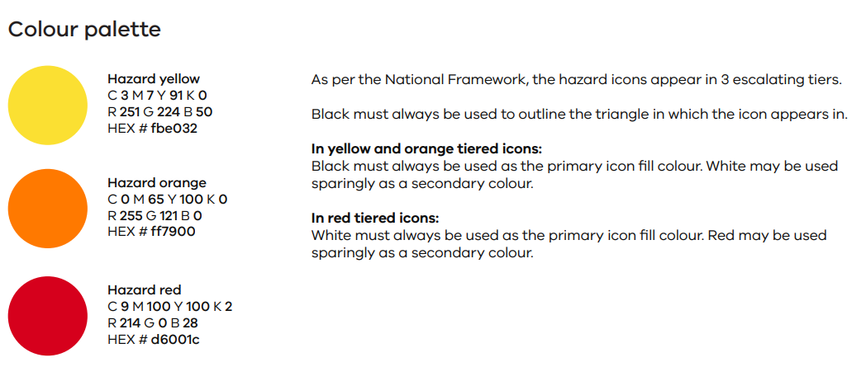
Australian Warning System Icons and Colours
The requirements of the Australian Warning System are nationally consistent:
1. Calls to Action statements – the bold and capitalised words in each template headline.
2. Warning levels – Advice, Watch and Act, Emergency Warning.
3. Colours - Advice is yellow, Watch and Act is orange, and Emergency Warning is red.
4. Icons

Slide 3
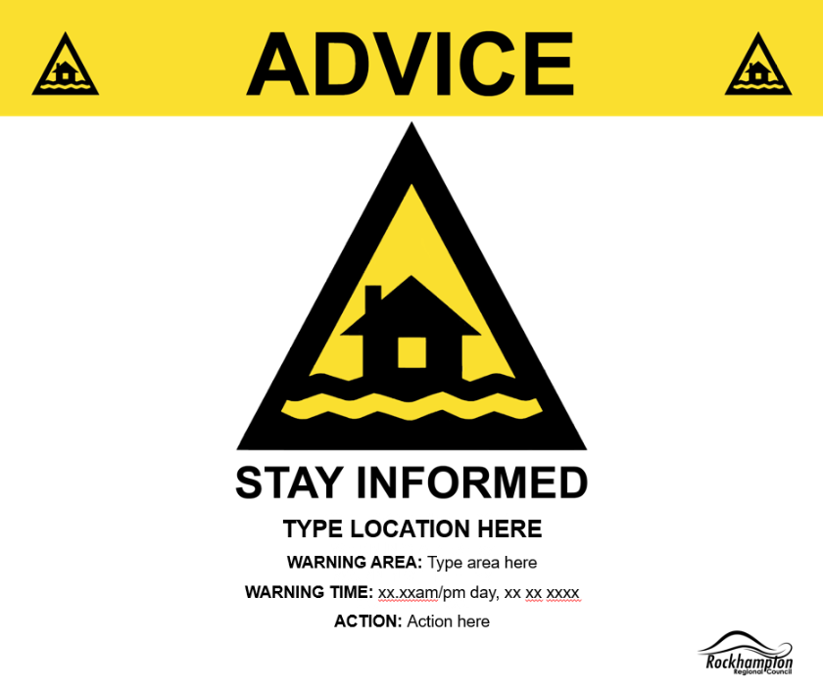
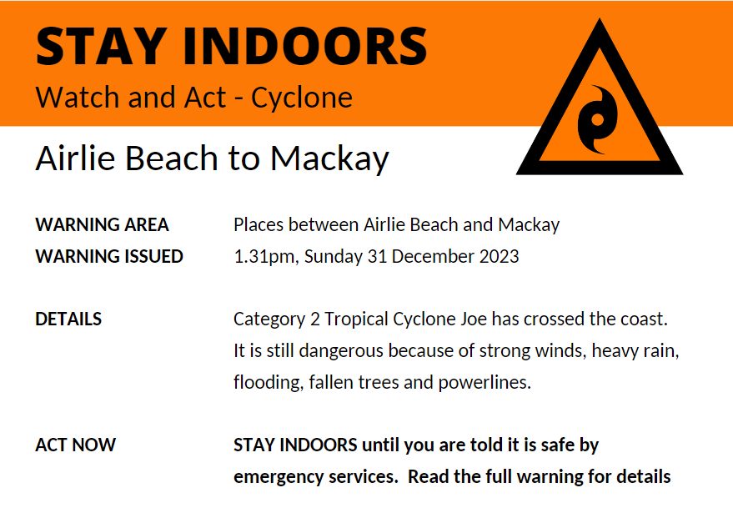
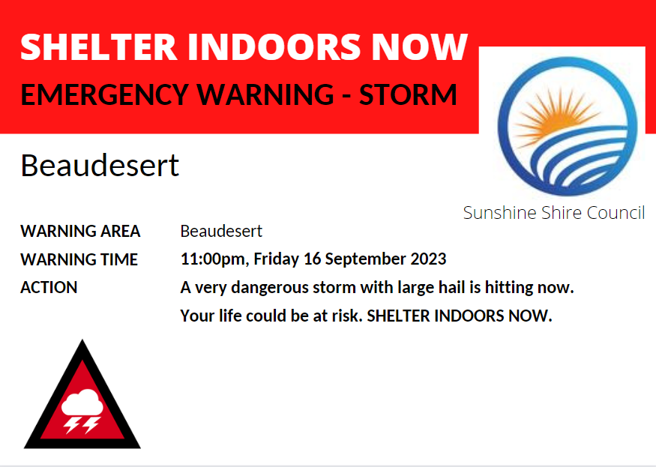


Style Guide
The triangular AWS hazard icon must be prominent on the social tile
Issuing Agency logos must be secondary
No other colours are to be used (i.e., a coloured background)
Use the right icon for the hazard and warning level

Slide 4
How to use these Social Tile Templates
Save a copy of this PowerPoint in your local system – a secure place that people who will be issuing warnings can all access. This will be your master document.
Fill in your ‘Call to Action Statement’ in BOLD and CAPS
Fill in your ‘Warning issued’ date and time
Fill in your ‘Warning area’
Fill in your ‘what you need to do’ information, this is the action for the community
Use your snipping tool to ‘snip’ and save the finished social tile.
Save it to your local system as a PNG or JPEG file, naming it in such a way that it can be quickly and easily found, and import to your platforms.

Slide 5

CALL TO ACTION STATEMENT
Severe Weather
warning
social tile templates
Advice - Severe Weather
WARNING ISSUED:
Time you are issuing the warning
Use the text boxes on the left to add your information.
- CALL TO ACTION STATEMENT
- Warning issued
- Warning area
- What you need to do
WARNING AREA:
Add broad warning area
Detailed warning locations
Detailed warning locations
WHAT YOU NEED TO DO:
Inject from the warning the key actions you want people to take (e.g., PREPARE NOW because conditions could become dangerous. Get your home ready. Keep asthma medication close by because storms and wind can trigger attacks.)

Slide 6

CALL TO ACTION STATEMENT
Severe Weather
warning
social tile templates
Watch and Act - Severe Weather
WARNING ISSUED:
Time you are issuing the warning
Use the text boxes on the left to add your information.
- CALL TO ACTION STATEMENT
- Warning issued
- Warning area
- What you need to do
WARNING AREA:
Add broad warning area
Detailed warning locations
Detailed warning locations
WHAT YOU NEED TO DO:
Inject from the warning the key actions you want people to take (e.g., MOVE or STAY INDOORS. Close doors and windows. Keep asthma medication close by because storms and wind can trigger attacks.)

Slide 7

CALL TO ACTION STATEMENT
Severe Weather
warning
social tile templates
Emergency Warning - Severe Weather
WARNING ISSUED:
Time you are issuing the warning
Use the text boxes on the left to add your information.
- CALL TO ACTION STATEMENT
- Warning issued
- Warning area
- What you need to do
WARNING AREA:
Add broad warning area
Detailed warning locations
Detailed warning locations
WHAT YOU NEED TO DO:
Inject from the warning the key actions you want people to take (e.g., SHELTER INDOORS NOW. Go inside a strong building now and shut doors and windows. Stay inside until the storm has passed. Keep asthma medication close by.)

Slide 8

CALL TO ACTION STATEMENT
Flood
warning
social tile templates
Advice - Flood
WARNING ISSUED:
Time you are issuing the warning
Use the text boxes on the left to add your information.
- CALL TO ACTION STATEMENT
- Warning issued
- Warning area
- What you need to do
WARNING AREA:
Add broad warning area
Detailed warning locations
Detailed warning locations
WHAT YOU NEED TO DO:
Inject from the warning the key actions you want people to take (e.g., STAY INFORMED because conditions could change quickly. Listen to warnings and tell friends and family in the warning area.)

Slide 9

CALL TO ACTION STATEMENT
Flood
warning
social tile templates
Watch and Act - Flood
WARNING ISSUED:
Time you are issuing the warning
Use the text boxes on the left to add your information.
- CALL TO ACTION STATEMENT
- Warning issued
- Warning area
- What you need to do
WARNING AREA:
Add broad warning area
Detailed warning locations
Detailed warning locations
WHAT YOU NEED TO DO:
Inject from the warning the key actions you want people to take (e.g., People in the warning area must MOVE TO HIGHER GROUND. Do not expect emergency services to come to your door. Take your emergency kit with you.)

Slide 10

CALL TO ACTION STATEMENT
Flood
warning
social tile templates
Emergency Warning - Flood
WARNING ISSUED:
Time you are issuing the warning
Use the text boxes on the left to add your information.
- CALL TO ACTION STATEMENT
- Warning issued
- Warning area
- What you need to do
WARNING AREA:
Add broad warning area
Detailed warning locations
Detailed warning locations
WHAT YOU NEED TO DO:
Inject from the warning the key actions you want people to take (e.g., People in the warning area must LEAVE IMMEDIATELY. Go now to a safe place in a high part of town. Do not expect emergency services to come to your door.)

Slide 11

CALL TO ACTION STATEMENT
Tropical Cyclone
warning
social tile templates
Advice - Tropical Cyclone
WARNING ISSUED:
Time you are issuing the warning
Use the text boxes on the left to add your information.
- CALL TO ACTION STATEMENT
- Warning issued
- Warning area
- What you need to do
WARNING AREA:
Add broad warning area
Detailed warning locations
Detailed warning locations
WHAT YOU NEED TO DO:
Inject from the warning the key actions you want people to take (e.g., People in the warning area should PREPARE NOW. Prepare your property. Check or make an emergency kit. Read the full warning to find out how.)

Slide 12

CALL TO ACTION STATEMENT
Tropical Cyclone
warning
social tile templates
Watch and Act - Tropical Cyclone
WARNING ISSUED:
Time you are issuing the warning
Use the text boxes on the left to add your information.
- CALL TO ACTION STATEMENT
- Warning issued
- Warning area
- What you need to do
WARNING AREA:
Add broad warning area
Detailed warning locations
Detailed warning locations
WHAT YOU NEED TO DO:
Inject from the warning the key actions you want people to take (e.g., PREPARE NOW TO TAKE SHELTER. Finish preparing your property and emergency kit. Move now to a safe place to shelter if you do not feel safe at home. Read the full warning for details.)

Slide 13

CALL TO ACTION STATEMENT
Tropical Cyclone
warning
social tile templates
Emergency Warning - Tropical Cyclone
WARNING ISSUED:
Time you are issuing the warning
Use the text boxes on the left to add your information.
- CALL TO ACTION STATEMENT
- Warning issued
- Warning area
- What you need to do
WARNING AREA:
Add broad warning area
Detailed warning locations
Detailed warning locations
WHAT YOU NEED TO DO:
Inject from the warning the key actions you want people to take (e.g., TAKE SHELTER NOW. Go immediately to the strongest and safest part of the building you are in. This could be a bathroom, hallway or walk-in wardrobe. Stay there.)

Slide 14
CALL TO ACTION STATEMENT
Storm Surge
warning
social tile templates
Advice - Storm Surge
WARNING ISSUED:
Time you are issuing the warning
Use the text boxes on the left to add your information.
- CALL TO ACTION STATEMENT
- Warning issued
- Warning area
- What you need to do
WARNING AREA:
Add broad warning area
Detailed warning locations
Detailed warning locations
WHAT YOU NEED TO DO:
Inject from the warning the key actions you want people to take (e.g., People in the warning area should PREPARE NOW FOR POSSIBLE STORM SURGE. Prepare your property. Check or make an emergency kit. Read the full warning to find out how.)

Slide 15
CALL TO ACTION STATEMENT
Storm Surge
warning
social tile templates
Watch and Act - Storm Surge
WARNING ISSUED:
Time you are issuing the warning
Use the text boxes on the left to add your information.
- CALL TO ACTION STATEMENT
- Warning issued
- Warning area
- What you need to do
WARNING AREA:
Add broad warning area
Detailed warning locations
Detailed warning locations
WHAT YOU NEED TO DO:
Inject from the warning the key actions you want people to take (e.g., PREPARE TO LEAVE. Decide now where you will go if the storm surge starts. Finish preparing your home and emergency kit. Read the full warning for details.)

Slide 16
CALL TO ACTION STATEMENT
Storm Surge
warning
social tile templates
Emergency Warning - Storm Surge
WARNING ISSUED:
Time you are issuing the warning
Use the text boxes on the left to add your information.
- CALL TO ACTION STATEMENT
- Warning issued
- Warning area
- What you need to do
WARNING AREA:
Add broad warning area
Detailed warning locations
Detailed warning locations
WHAT YOU NEED TO DO:
Inject from the warning the key actions you want people to take (e.g., LEAVE IMMEDIATELY. You are in danger. Get family, pets and your emergency kit and go immediately to a safe place away from the storm surge.)

